Slide 1

Project Task Client X
By Eva Santing

Slide 2
Content
Top 10 Customer Sales Data in the last 2 years (2020-2021)
Sales Data of the highest selling distributor (OFFYoRm) in July 2021
The Impact of Covid on Sales
Year on Year change in sales per Product Category
Data Quality and Completeness

Slide 3
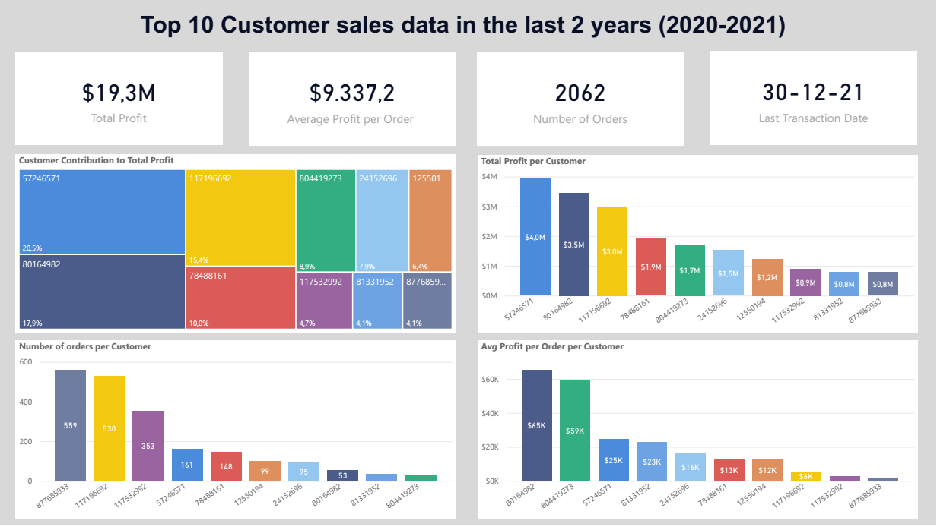

Slide 4
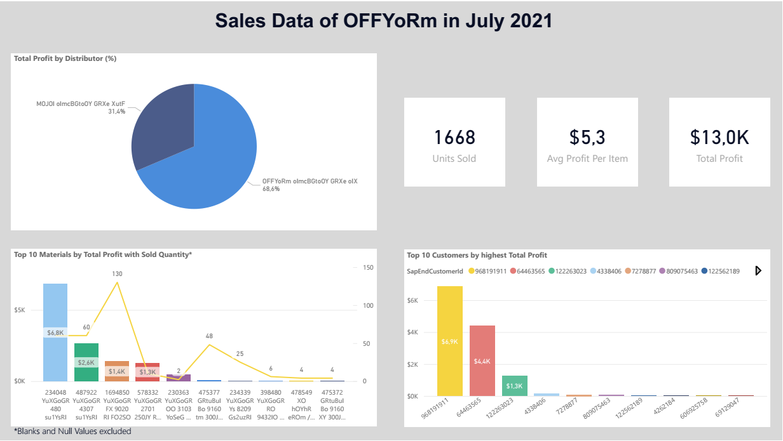

Slide 5
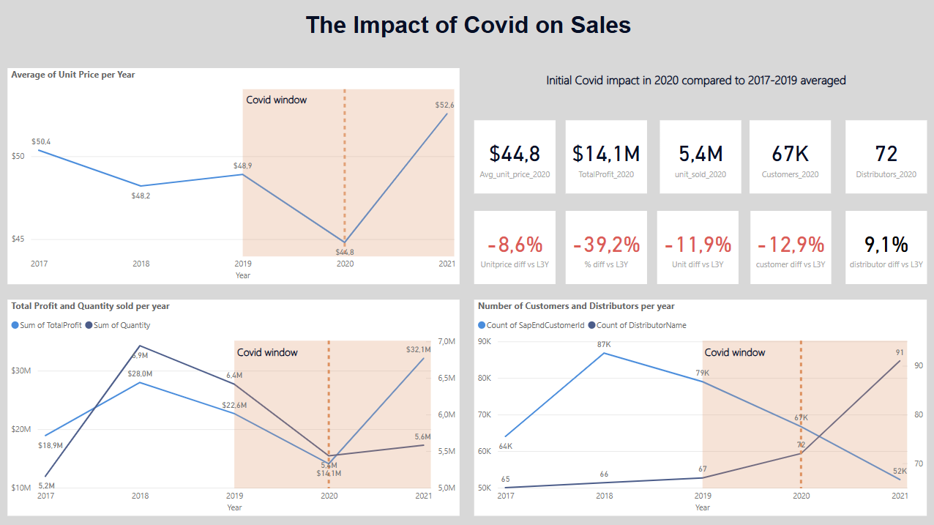

Slide 6
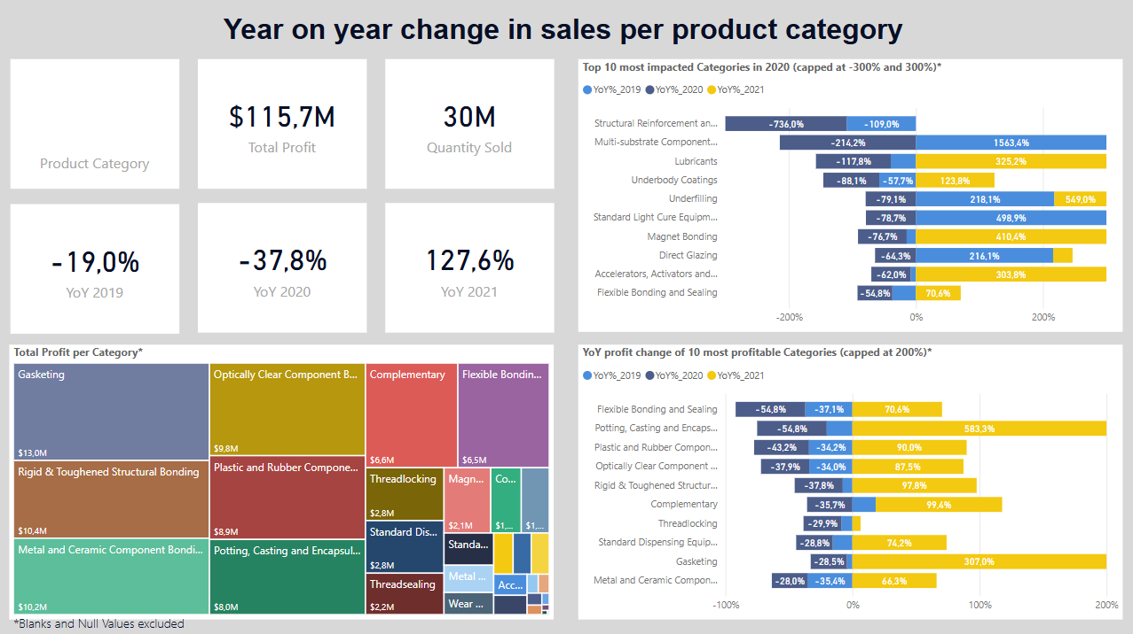

Slide 7
Data Quality and Completeness
No proper documentation available for several columns.
Duplicate SAP ID/Name entries – Created a combination column to resolve this.
Missing records – Older sales (mainly from 2017) had productcode entries not found in the product file.
Punctuation inconsistencies – Periods (.) used instead of commas (,) for US formatting, causing issues; corrected to proper format.
Negative profit values found in multiple products.
Randomly generated names were difficult to interpret – Suggested more distinguishable names.
Distributor inconsistencies – More distributor IDs than names, with multiple IDs assigned to the same distributor.
Overall data quality score: 6/10 – Incomplete, required improvisation, but no additional info was needed to complete the task.

